Slide 1
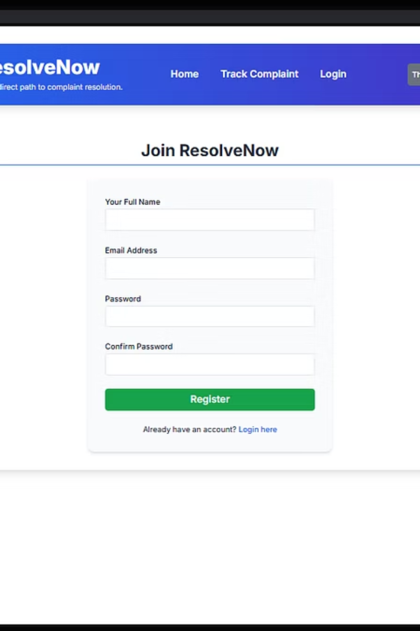
ResolveNow: Streamlining Your Workflow
Welcome to the ResolveNow project presentation. We're excited to share our journey in developing an innovative solution designed to simplify and accelerate your problem-solving processes.
Presented By: MUNISETTI PRAVALLIKA(Team Leader)

Slide 2

Ideation Phase: Understanding the Core Challenge
Project Overview
Purpose
Problem Statement
ResolveNow aims to create a comprehensive platform for efficient issue resolution and task management, enhancing team collaboration.
To deliver a user-centric solution that reduces resolution times, improves communication, and provides clear insights into project progress.
Current methods for issue tracking are often fragmented, leading to delays, miscommunication, and a lack of transparency.

Slide 3
Deep Dive into User Needs: Empathy and Brainstorming
Empathy Map Canvas
Brainstorming Solutions
We thoroughly explored our users' needs, pain points, and aspirations through an empathy map, ensuring our solution addresses real-world challenges.
Our team engaged in intensive brainstorming sessions, generating a wide array of creative solutions to address the identified problems.
What users say, think, feel, and do.
Divergent thinking for idea generation.
Understanding user motivations.
Collaborative ideation workshops.
Identifying frustrations.
Prioritizing impactful features.

Slide 4




Requirement Analysis: Mapping the User Journey
Customer Journey Map
Solution Requirements
Data Flow Diagram
Visualizing the end-to-end customer experience helped us pinpoint critical interaction points and opportunities for improvement.
Based on the journey map, we defined precise functional and non-functional requirements for the ResolveNow platform.
A detailed DFD illustrates how data moves through the system, ensuring logical consistency and integrity.

Slide 5
Technology Stack & Project Design
Technology Stack
Problem-Solution Fit
We selected a robust and scalable technology stack to ensure ResolveNow's performance, security, and future adaptability.
Our proposed solution directly addresses the identified problems, offering intuitive features that streamline workflow.
Frontend: React.js, HTML5, CSS3Backend: Node.js, Express.jsDatabase: MongoDBCloud: AWS Services (EC2, S3, RDS)
Proposed Solution
ResolveNow is a cloud-based platform with real-time collaboration, AI-powered suggestions, and comprehensive analytics.
Solution Architecture
A microservices architecture ensures modularity, scalability, and ease of maintenance for the entire system.

Slide 6
Project Planning and Quality Assurance
Project Planning
Functional and Performance Testing
Our meticulous project plan outlines key phases, deliverables, timelines, and resource allocation, ensuring a smooth development process.
Rigorous testing ensures ResolveNow meets all functional requirements and performs optimally under various loads.
Automated unit and integration tests.
Agile methodology for iterative development.
Load and stress testing for performance.
Defined sprints and milestones.
User acceptance testing (UAT).
Risk assessment and mitigation strategies.

Slide 7
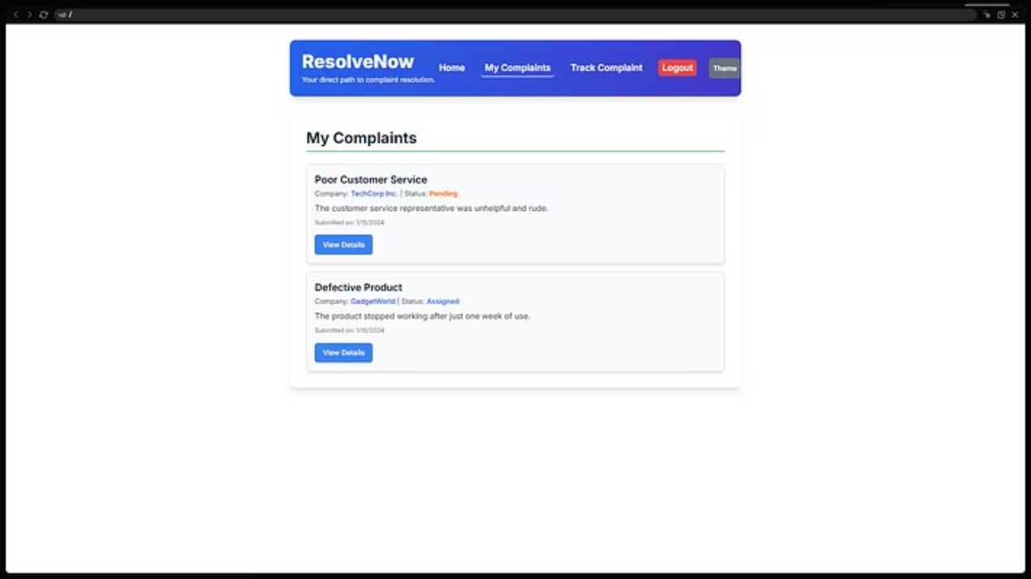
Results: ResolveNow in Action
We are proud to present the tangible results of the ResolveNow project. The platform offers a clean, intuitive interface that simplifies complex workflows.

Slide 8

Conclusion and Future Outlook
1
Advantages
2
Disadvantages
ResolveNow significantly boosts productivity, enhances team collaboration, provides real-time insights, and offers a highly scalable and secure architecture.
Initial user adoption may require training, and extensive customization for niche industries may involve additional development.
3
Future Scope
4
Appendix
Upcoming features include AI-powered predictive analytics, mobile app development, and integrations with popular third-party tools.
Access our source code, dataset, and project demo for a deeper dive into ResolveNow's technical aspects.

